Slide 1

Intrinsic Transport Properties & Scattering Mechanisms in TMDs
Dept. of Physics & Astronomy
Kraig Andrews
Nanofabrication & Electron Transport Laboratory

Slide 2
Overview
Motivation
Introduction
Device Fabrication
Preliminary Results
Future Work & Conclusion

Slide 3
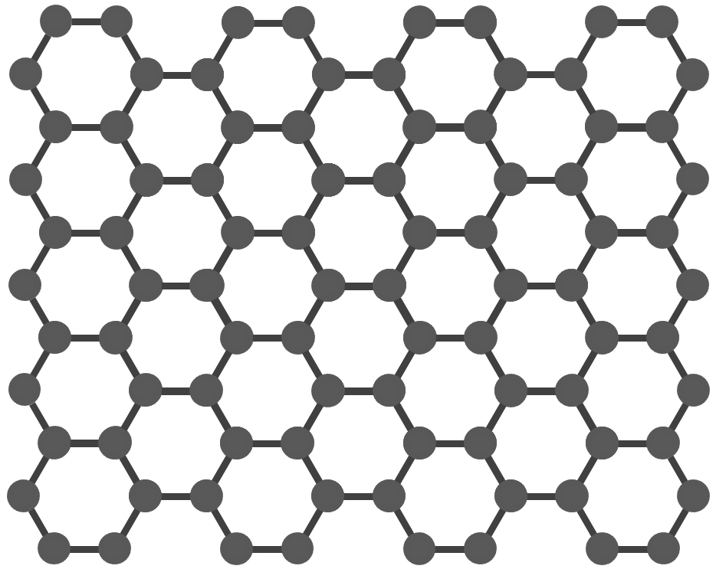
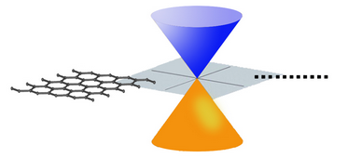
Graphene
High mobility
10⁴ cm²V⁻¹s⁻¹ at T_{room}¹
Upper limit 10⁵ cm²V⁻¹s⁻¹ at T_{room}²
High Young’s Modulus
No Bandgap³
Low I_{on}/I_{off} ratio
Notes:
Upper limit is for suspended graphene (i.e. removed substrate)

Slide 4
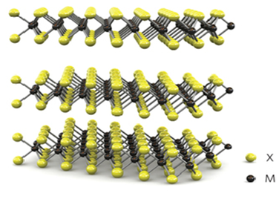
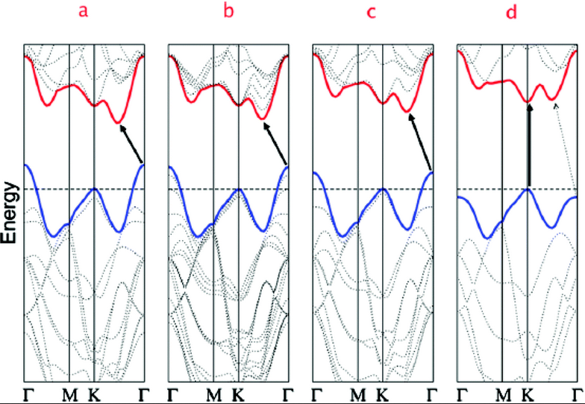
TMDs
Transition Metal Dichalcogenides (TMDs)
Transition Metal Chalcogen
Mo, W, V S, Se, Te
MX₂
(MoS₂, MoSe₂, WSe₂, WS₂)
Unique Band structure³
Extremely Strong
High I_{on}/I_{off} ratio > 10⁶
Notes:
Band structure for (a) bulk MoS2, (b) four-layer MoS2, (c) bi-layer MoS2, and (d) Monolayer MoS2. Shows transition from indirect bandgap to direct bandgap. Arrows indicate the lowest energy transitions.

Slide 5
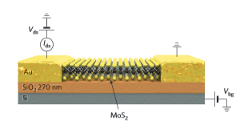
Field Effect Transistors (FETs)
Si/SiO₂ substrate
TMD channel
Ti/Au electrodes
Source Channel Drain

Slide 6
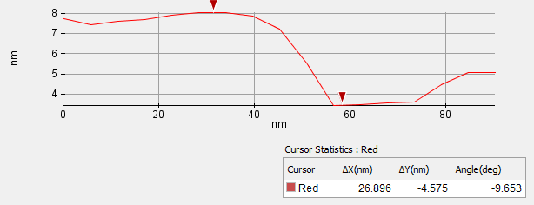
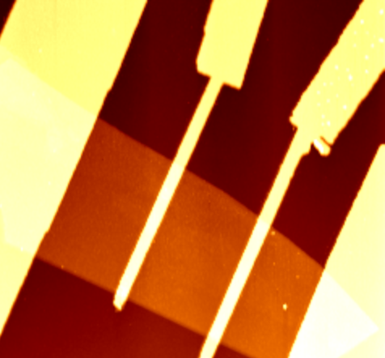
Device Characterization
AFM

Slide 7
Challenges
Contact Resistance
Schottky barrier & mobility
Scattering mechanisms
Understand impact on mobility
Study p-WSe₂ doping effects
Impurities & mobility degradation
Performance limits
Device applications

Slide 8
Mobility & Scattering
How to measure FET performance?
Mobility μ
μ limited by scattering:
Optical phonons
Acoustic phonons
Interface scattering
Impurities/channel defects
Intrinsic
Extrinsic
Study these mechanisms & how they effect device performance

Slide 9
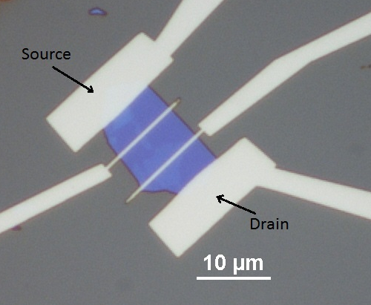
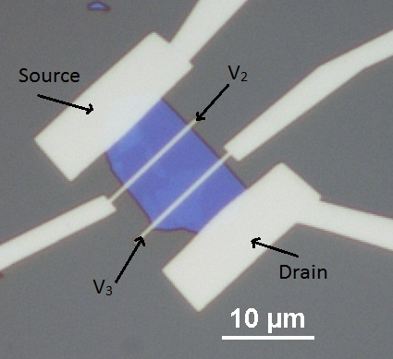
Field-Effect Mobility μ_{FE}
Two-probe R_{c} affected
Four-probe R_{c} substracted

Slide 10
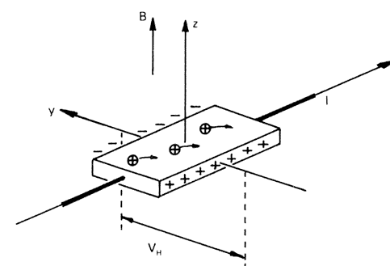
Hall Mobility μ_{H}
μ_{H}
Conductivity
Carrier density
μ_{RT} ~ 10-10² cm²V⁻¹s⁻¹
-Doped WSe₂
μ_{Low-T} ~ 10⁴ cm²V⁻¹s⁻¹
-MoS₂

Slide 11
Temperature Dependence of μ
High Temperature
Phonon scattering dominated
T , μ
Low Temperature
Diminished phonon scattering
Coulomb, impurity, interface, defects dominated
T , μ

Slide 12
Contacts/SB
Low contact resistance μ increased
Schottky barrier (SB)
Fermi level mismatch at metal/semiconductor interface
How to reduce SB height and width
Metal work functions
Graphene contact interface
Notes:
Large Rc at RT is bad for device applic.
Bad for RT mu_fe

Slide 13
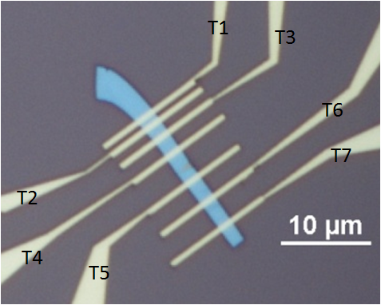
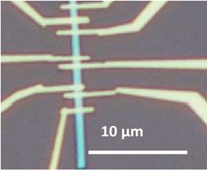
Approach
2D/2D Contacts
Contact Resistance
Nb_{0.0005}W_{0.9995}Se₂
Doping Lower SBH
Nb_{0.005}W_{0.995}Se₂¹

Slide 14
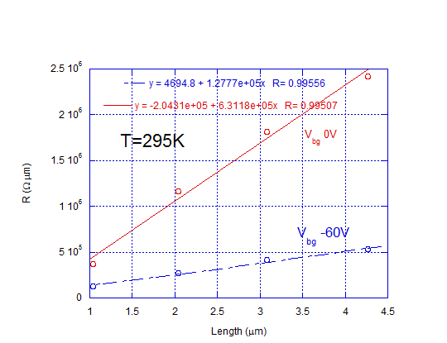
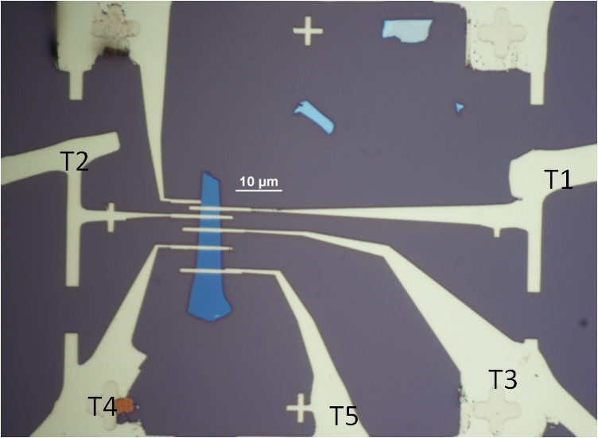
Nb_{0.0005}W_{0.9995}Se₂ (0.05%)
Nb_{0.0005}W_{0.9995}Se₂

Slide 15
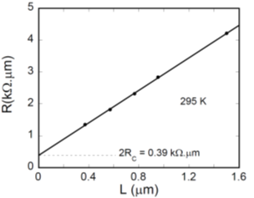
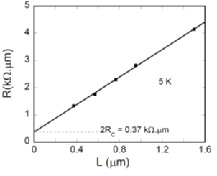
Nb_{0.005}W_{0.995}Se₂ (0.5%)
Nb_{0.005}W_{0.995}Se₂¹
Notes:
Contact Resistances for 0.05% Nb doped WSe2 at room temp (R_{c} = 2.35 kΩ μm), 0.5% Nb doped WSe2 at room temp (R_{c} = 0.195 kΩ μm) and at 5K (R_{c} = 0.185 kΩ μm).

Slide 16
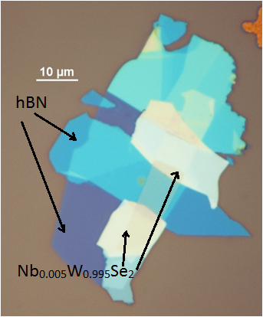
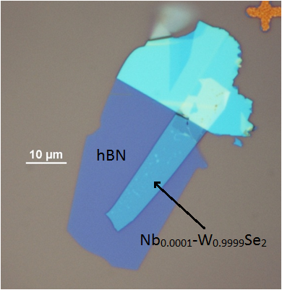
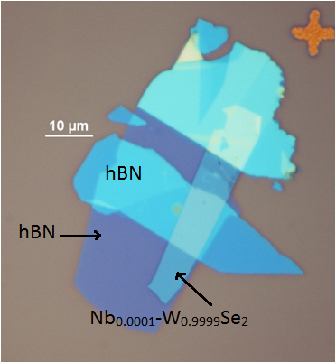
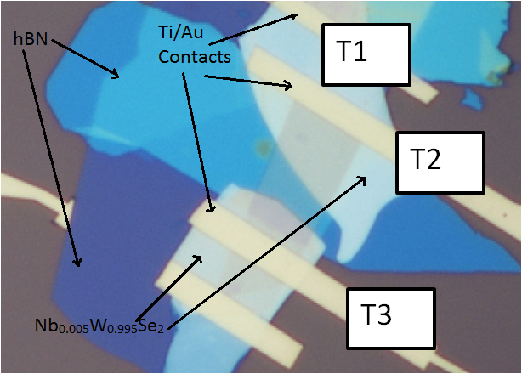
Fabrication

Slide 17
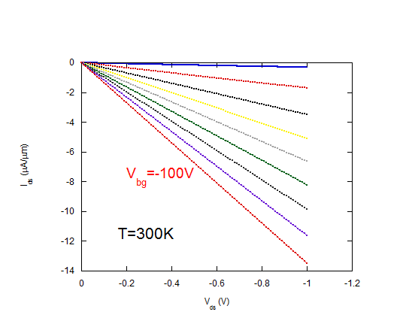
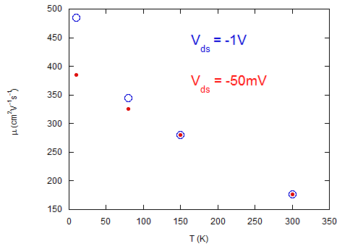
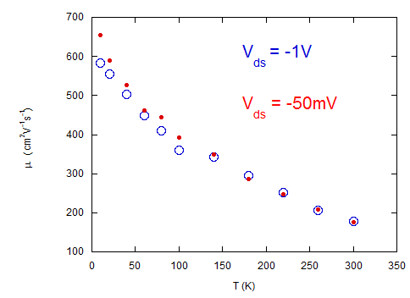
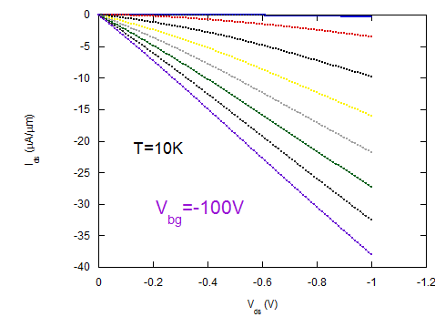
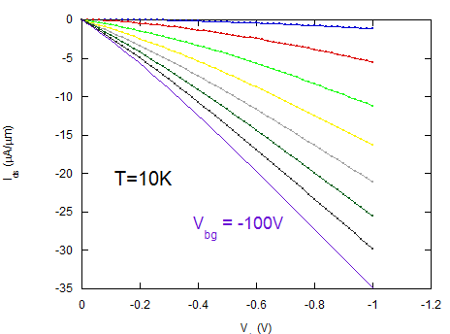
2-Probe μ_{FE} Doped Contacts (0.5%)
Doped Channel (0.01%)
Before annealing at 250º C for 30 min.
After annealing at 250º C for 30 min.
Nb_{0.0001}W_{0.9999}Se₂ Channel & Nb_{0.005}W_{0.995}Se₂ Contacts

Slide 18
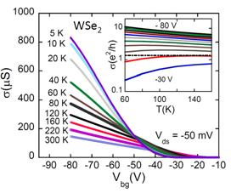
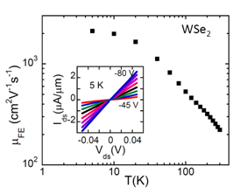
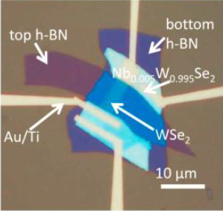
2-Probe μ_{FE} Doped Contacts (0.5%)
Undoped Channel
Undoped Wse₂ Channel & Nb_{0.005}W_{0.995}Se₂ Contacts¹

Slide 19
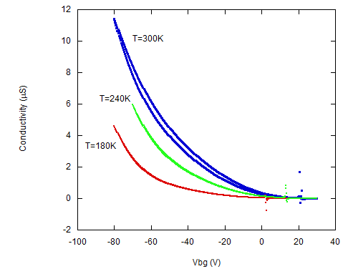
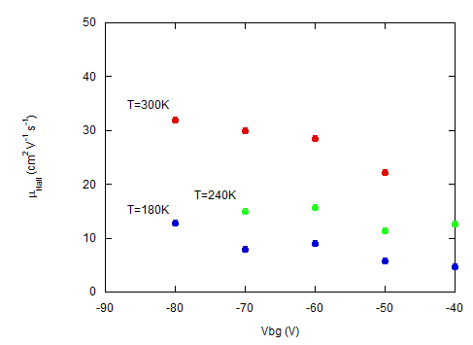
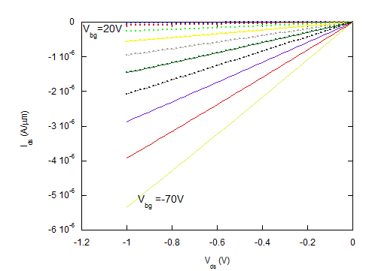
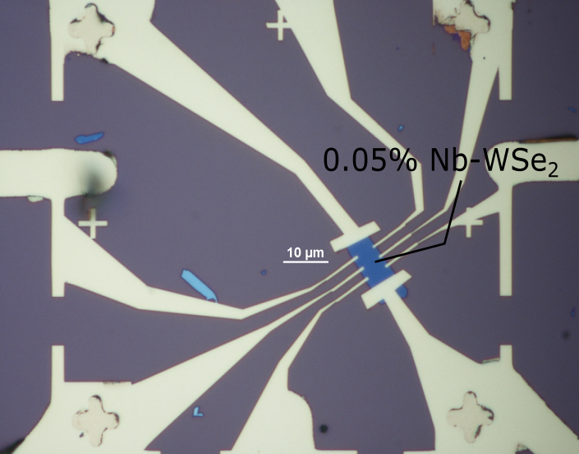
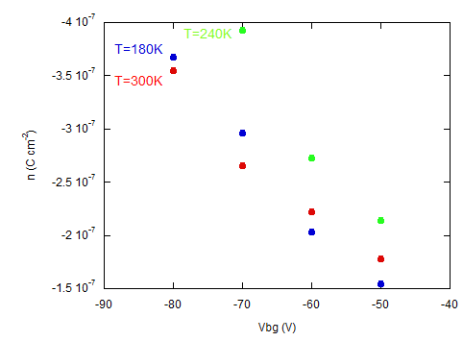
Nb_{0.0005}W_{0.9995}Se₂ μ_{H}
Nb_{0.0005}W_{0.9995}Se₂ Doped Channel
Notes:
Slope for n vs. vbg gives cap. And should be similar for all temps

Slide 20
Quantum Transport
Integer Quantum Hall Effect (IQHE) & Shubnikov-de Haas (SdH) oscillations
Low Temperature (< 4K)
High Magnetic Field (~10 T)
High µ at Low T Required

Slide 21
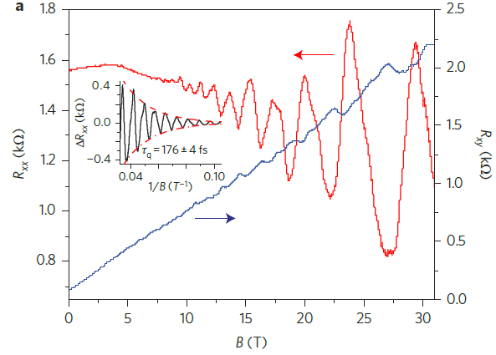
SdH & IQHE in MoS₂
τ_{q-MoS2-1L} = 0.18 ps⁵
τ_{q-BP-10nm} = 0.12 ps⁶
Device quality
Cyclotron effective m
m_{electrons,} m_{holes}

Slide 22
Performance Limits
Theoretical 1L mobility at T=295K⁷
~320-410 cm²V⁻¹s⁻¹
Experimental mobility at T=295K⁸
~200 cm²V⁻¹s⁻¹
I_{on}/I_{off} > 10⁷, I_{on} ~ 300 μA/μm
How to close theoretical/experiment gap

Slide 23
Summary
2D/2D contact strategy to lower R_{contact}
Improve μ through hBN encapsulation
Determine quantum properties using low T and high B environment
Room T performance limits

Slide 24
Acknowledgements
The authors would like to acknowledge:
Nanofabrication and Electron Transport Laboratory students:
Hsun Jen Chuang, Bhim Chamlagain, Meeghage Madusanka Perera, Arthur Bowman III, Upendra Rijal, and Sagar Paudel
Committee Members: Dr. Zhixian Zhou,
Dr. Jian Huang, Dr. Ashis Mukhopadhyay, Dr. Mark Cheng

Slide 25
Field-effect transistor
Device characteristics
Field-effect mobility
Hall mobility
Temperature dependence of mobility

Slide 26
Contacts
Schotttky barrier

